Slide 1
Streamlined Model Composition for OneSAF for Use in Rapid Trade Study Data Collection and Analysis
Oleg Sapunkov, PhD
Bradshaw Roberts
Maxwell Jorgensen
DISTRIBUTION STATEMENT A.
Approved for public release; distribution is unlimited. OPSEC #10930

Slide 2

ONESAF
Constructive Simulation maintained by PM Simulation.
OneSAF’s capabilities include multiple levels of fidelity from unit level to theater wide simulations.
OneSAF includes data collection systems that enable comprehensive trade space analysis across complex problem domains.
To maximize the utility of OneSAF's robust simulation capabilities, our work introduces a system that rapidly translates large-scale groups of vehicle configurations into functional OneSAF models.
All numeric values shown are notional and for illustration only​

Slide 3
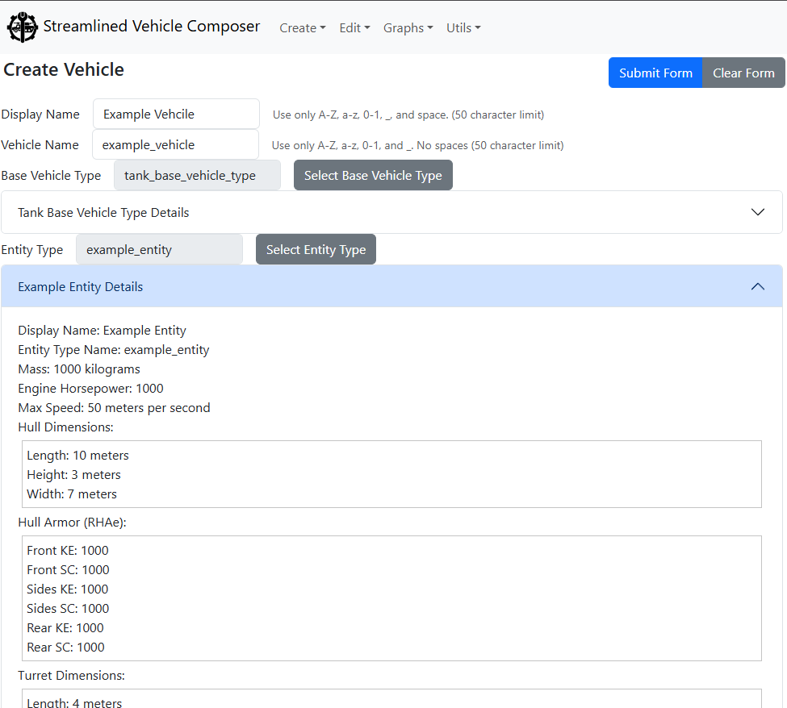

SVC
Streamlined Vehicle Composer (SVC)
A tool developed to:
Translate data from experiments
Composes functional OneSAF models, such as vehicles, weapons, and munitions.
Enables the rapid construction and evaluation of differing vehicle variants in a fraction of the baseline process time.
All numeric values shown are notional and for illustration only​
Notes:
The Streamlined Vehicle Composer is a tool created to quickly compose and modify vehicles, and other OneSAF models, including weapons, munitions, and sensors.
A tool developed to translate experimational data to OneSAF
Translation of bulk datasets into functional OneSAF models, enabling the rapib construction and evalution of differing vehicle variants in a fraction of time of the baseline process

Slide 4
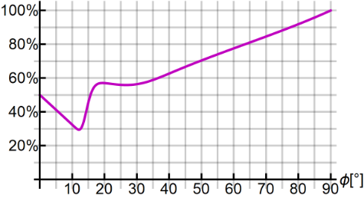
SVC and a Direct Fire Model
For the SVC to properly export a OneSAF model, it needs to calculate the required vulnerability data first.
A translation was needed to output the data taken from Virtual Experiments into the format used by OneSAF. This translation has resulted in a direct fire model that calculates the expected penetration depth. The model evaluates weapon-armor combinations while accounting for shot variability and the angle of approach relative to the armor.
The model is composed of two combined parts:
- The Probability of Hit
- The Probability of Penetration
All numeric values shown are notional and for illustration only​
Notes:
Explain precisely what the concepts of prob. Of hit and prob. Of penetration. Explain what OneSAF does in a "vulnerability event"

Slide 5
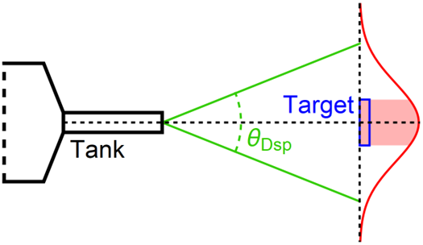
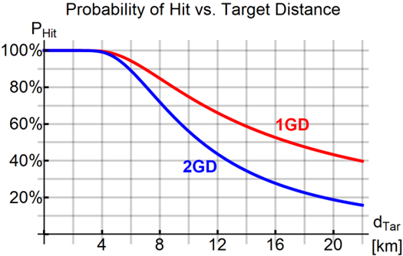
Direct Fire Model: Base Probability of Hit
If we assume that gun dispersion is a bivariate Gaussian distribution, we can calculate the probability of hit given a distance from the target.
Target: 5m Square
Dispersion: 0.05 degrees
All numeric values shown are notional and for illustration only​
Notes:
FIX

Slide 6
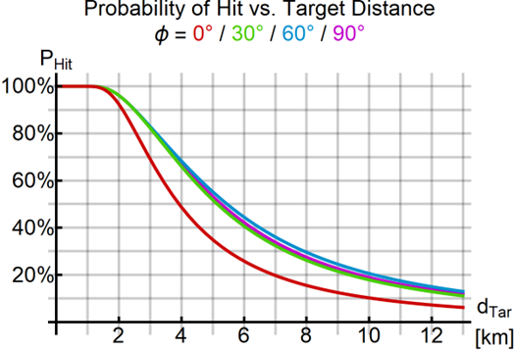
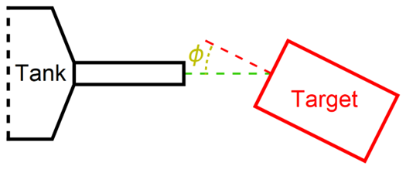
Direct Fire Model: Probability of Hit with Angled Target
If we improve our assumption to take into account the orientation of the target vehicle and the adjusted effective target area, we get a result for probability of hit.
Target: 6m x 3m x 3m
Dispersion: 0.0833 degrees
All numeric values shown are notional and for illustration only​
Notes:
FIX

Slide 7
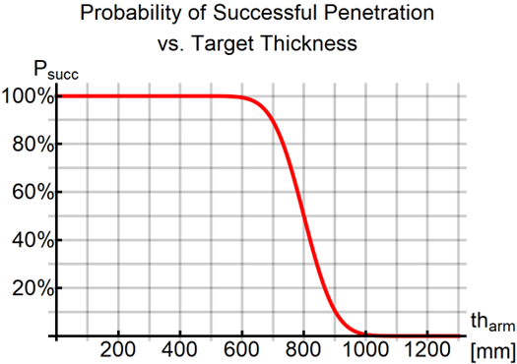
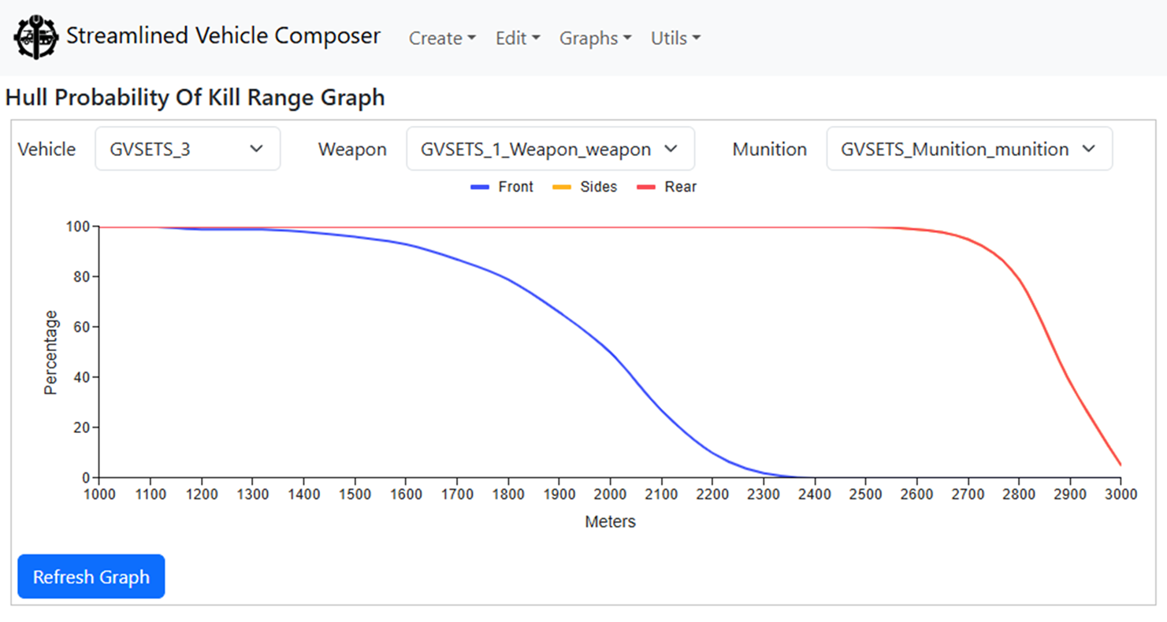
Direct Fire Model: Probability of Successful Penetration
The depth of penetration needs to be deeper than the thickness of the hit armor.
This is dependent on the effective thickness of the armor.
All numeric values shown are notional and for illustration only​
Notes:
Specify Target Thickness versus distance to target. Explain why it is a distribution

Slide 8
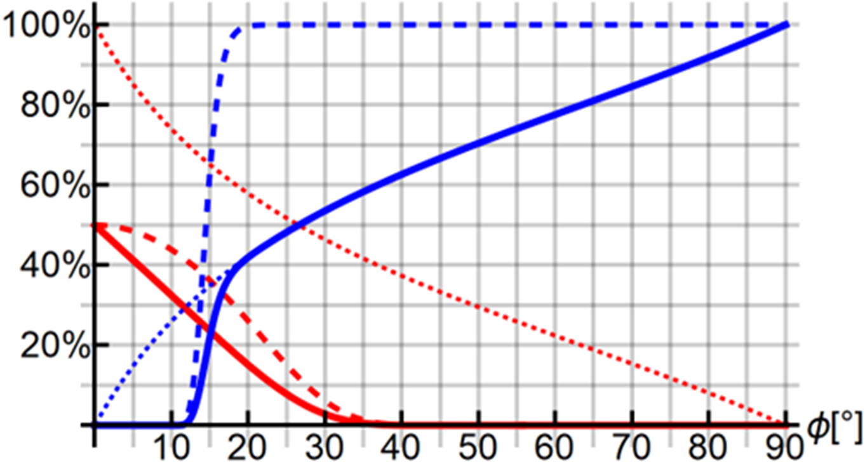
Direct Fire Model: Resulting Graphs
The cross-over around 15 degrees is where the effective armor is the thickest.
The cross-over around 27 degrees is where the effective armor is comprised mostly of side armor.
Front
Side and Rear
Dots: Probability of Hit
Dashes: Probability of Penetration Given Hit
Solid: Combined Probabilities
All numeric values shown are notional and for illustration only​
Notes:
Add Key

Slide 9
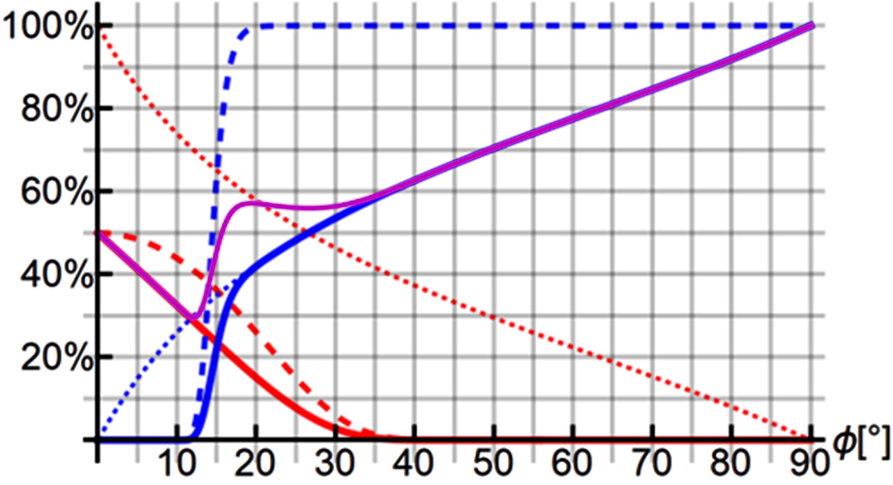
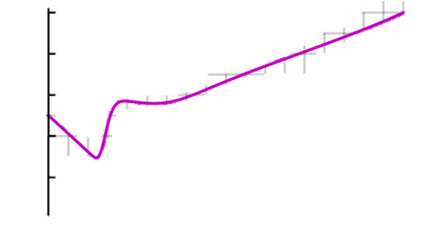
Direct Fire Model: Resulting Graphs
The final resulting graph, in purple, shows the probability of penetration in relation to the angle of the target vehicle relative to the firing vehicle.
Front
Side and Rear
Dots: Probability of Hit
Dashes: Probability of Penetration Given Hit
Solid: Combined Probabilities
All numeric values shown are notional and for illustration only​

Slide 10
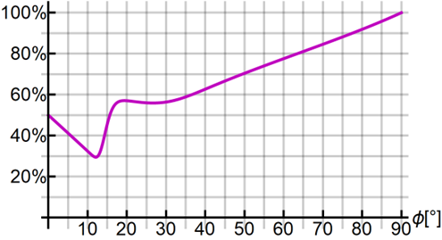
Direct Fire Model: Resulting Graphs
The final resulting graph, in purple, shows the probability of penetration in relation to the angle of the target vehicle relative to the firing vehicle.
All numeric values shown are notional and for illustration only​

Slide 11
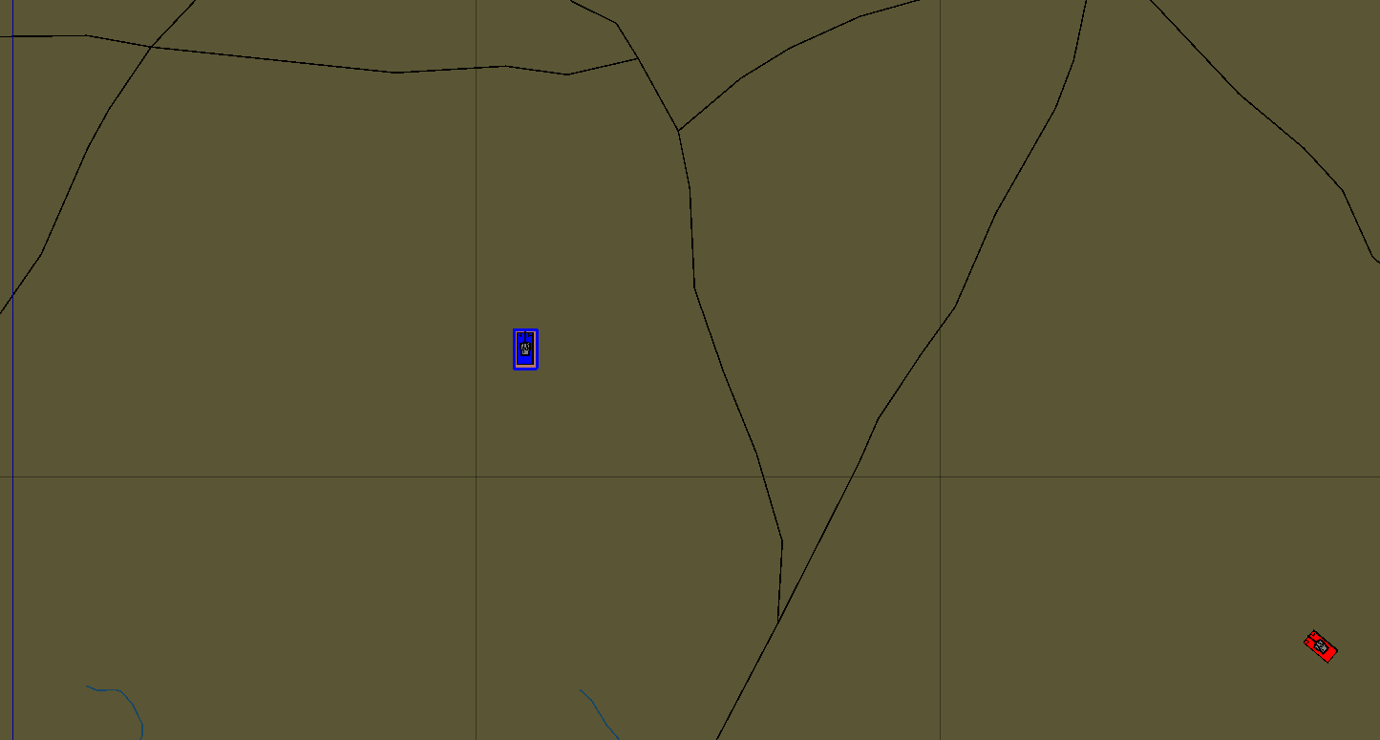
Armor Experiment Design
The Armor Experiment was a sample meant to demonstrate the trade study potential of OneSAF with the SVC used as the primary model composition backbone.
Six vehicles were modeled in the SVC:
- 5 BLUFOR defenders with differing armor packages
- An OPFOR aggressor
The aggressor would repeatedly fire upon the
defender until significant damage was sustained.
The test would be repeated 100 times per
configuration at 15° intervals around the defender
to test the front, side, and rear armor.

Slide 12

Aggressor Weapon
The aggressor main gun:
Fictious 125mm APFSDS main cannon
An expected muzzle velocity of 1800 m/s.
At 2 km, the expected penetration depth is 700 mm of RHA.
The aggressor’s directive:
Continue firing until the defender vehicle was destroyed
Or the simulation time limit of 1 hour was reached.
The aggressor was given infinite ammunition, which allowed us to track the average time to kill for any position of the armor package.
All numeric values shown are notional and for illustration only​

Slide 13

Defender Armor Packages
The 5 defender armor packages were constructed around the expected penetration depth of the aggressor vehicle’s main gun.
Vehicle 1:
- 600 mm RHA front
- 300 mm RHA side and rear
Vehicle 2:
- 650 mm RHA front
- 325 mm RHA side and rear
Vehicle 3:
- 700 mm RHA front
- 350 mm RHA side and rear
The OPFOR’s main gun had an expected penetration depth of 700 mm at 2 km.
Due to OneSAF’s built in variability, all 5 vehicles have at least an 8% chance of being penetrated through the front armor.
Vehicle 4:
- 750 mm RHA front
- 375 mm RHA side and rear
Vehicle 5:
- 800 mm RHA front
- 400 mm RHA side and rear
All numeric values shown are notional and for illustration only​

Slide 14
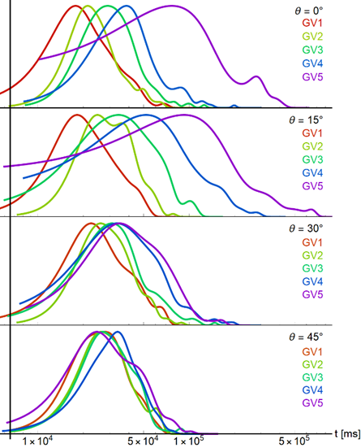
Armor Experiment Results
The primary measured variable was Time to Kill (i.e. Time to First Penetration).
The distribution of Time to Kill per vehicle package for the
angles 0 to 15 degrees shows that as the aggressor moves
to the side, the Time to Kill across all vehicles starts
to converge.
All numeric values shown are notional and for illustration only​
Notes:
Explain Time to Kill, Connect it to the probabilities

Slide 15
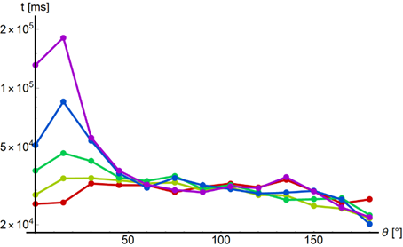
Armor Experiment Results Continued
The probability calculated from the model has an inverted correlation with the Mean Time to Kill.
All numeric values shown are notional and for illustration only​

Slide 16

Armor Experiment Results Continued
The spike at 15 degrees in the Time to Kill graphs correlates to the dip seen in the probability of penetration graph due to the effective thickness of the armor packages.
All numeric values shown are notional and for illustration only​

Slide 17
Armor Experiment Results Continued
After the 45-degree angle, all 5 vehicle configurations had effectively the same Time to Kill, which was ~3 seconds, due to the aggressor taking time to identify the target at the start of each simulation.
All numeric values shown are notional and for illustration only​
Notes:
Be precise that there is a discrete amount of time that must pass for a shot, hence why it tails off.

Slide 18
Results Otherwise Known as “So What?”
The armor experiment was conceived as a “toy problem” that could be used to demonstrate the trade-space study capabilities of OneSAF.
Integrating the SVC into the workflow streamlines OneSAF model generation, reducing transition times between experimental testing and simulation environments.
Other use cases for OneSAF could also be enhanced using external tools and development to further enhance its capability in those areas.
All numeric values shown are notional and for illustration only​

Slide 19
Thank You
Questions?
All numeric values shown are notional and for illustration only​

